Slide 1
EIT x Soft Robots: project update
Week of Monday 26/07/2021

Slide 2
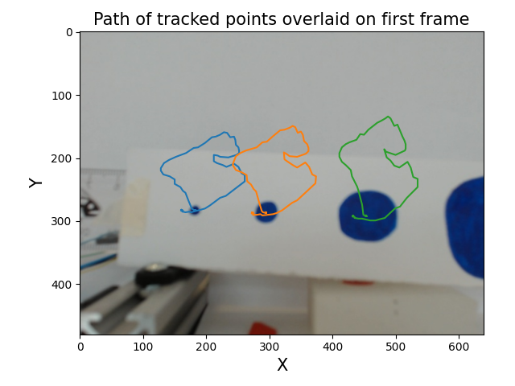
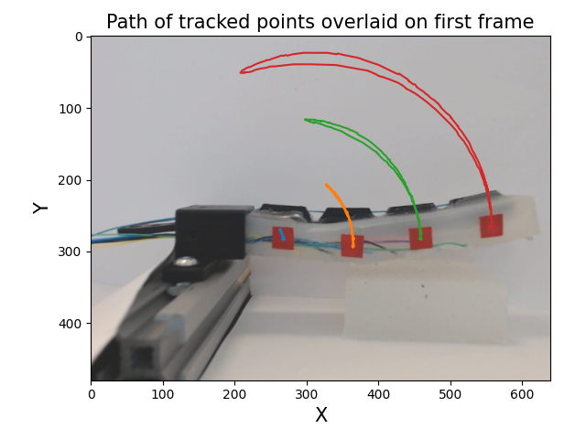
EIT data of SDM actuator in stepper rig – less noise/fewer errors in data

Slide 3
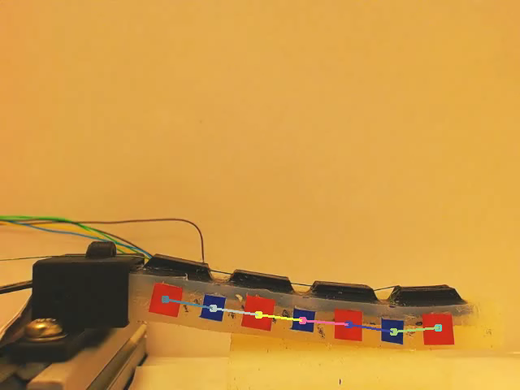
OpenCV point tracking

Slide 4
OpenCV point tracking on actuator

